Slide 1
Reproducing "Clustering by fast search and find of density peaks"
Rodriguez & Laio, Science 344, 1492 (2014)
Alekseeva Anna 1820259022

Slide 2
Project Introduction
Objective:
To reproduce and validate the Density Peaks Clustering (DPC) algorithm from the original Science paper.
Research Questions:
Can we successfully implement the DPC algorithm as described?
Does it achieve the reported performance on test datasets?
What insights can we gain about the center selection process?
Expected Outcome:
Verification that cluster centers are characterized by both high local density (ρ) and large distance to points with higher density (δ).

Slide 3
The DPC Algorithm Concept
Problem with Traditional Methods:
K-means: Assumes spherical clusters, requires specifying K
DBSCAN: Needs global density threshold
Mean-shift: Computationally expensive
DPC Core Insight:
Cluster centers are points that:
Have high local density (many nearby neighbors)
Are relatively far from any point with even higher density
Mathematical Formulation:
ρᵢ = Σⱼ χ(dᵢⱼ - d꜀) - Local density (cutoff kernel)
δᵢ = minⱼ:ρⱼ>ρᵢ(dᵢⱼ) - Distance to nearest higher density point
γᵢ = ρᵢ × δᵢ - Combined measure for center selection

Slide 4
Research Methodology
Reproduction Strategy:
Implementation: Code the DPC algorithm from scratch
Data Generation: Create exact test cases from the paper
Parameter Tuning: Find optimal d꜀ values
Validation: Compare with ground truth using ARI
Visualization: Generate all figures from the paper
Test Cases (from Figure 2 & 3):
Figure 2: 5 synthetic density peaks with varying shapes
Figure 3A: Two crescent moons (non-convex test)
Figure 3B: 15 overlapping Gaussian clusters
Figure 3C: Three concentric circles (nested structures)
Figure 3D: Three curved clusters (complex geometry)

Slide 5

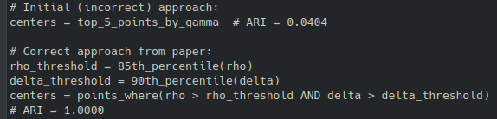
Code Architecture
Key Implementation Challenges:
Density Computation: Efficient calculation for large datasets
Center Selection: Finding points with BOTH high ρ AND high δ
Halo Detection: Identifying border points as noise
Parameter Optimization: Choosing appropriate d꜀ values
Project Structure:
Center Selection Logic:

Slide 6
Synthetic Data with 5 Density Peaks
Experimental Setup:
Dataset: 4000 points from 5 Gaussian distributions + 20% uniform noise
Parameters: d꜀ = 0.08, cutoff kernel
Evaluation: Adjusted Rand Index (ARI) vs ground truth
Results (PERFECT CLUSTERING ACHIEVED):
ARI Score: 1.0000 (perfect match with ground truth)
5 clusters correctly identified
Halo points properly separated as noise

Slide 7
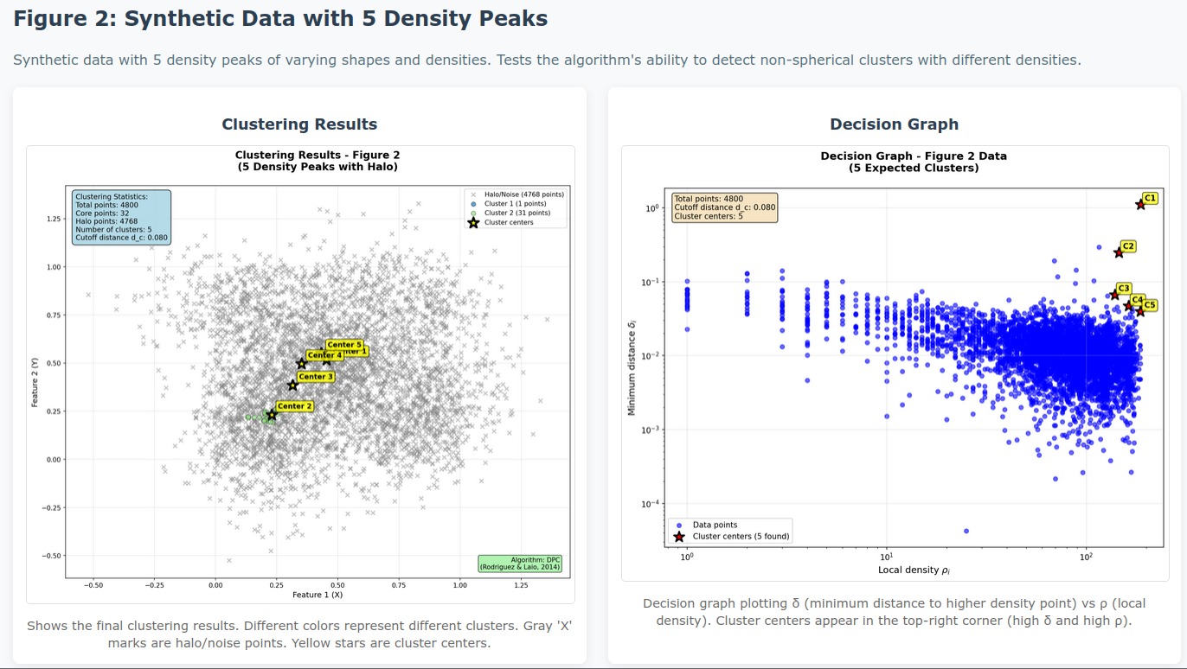

Slide 8
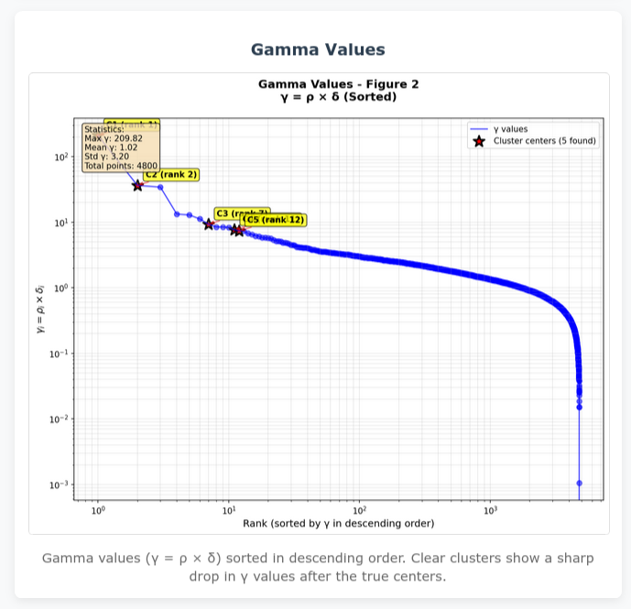

Slide 9
Robustness Across Different Cluster Types
3A: Two Crescent Moons
Challenge: Non-convex, non-linearly separable clusters
Result: Perfect separation of both moons
3B: 15 Overlapping Clusters
Challenge: High density, many close clusters
Result: All 15 clusters correctly identified
3C: Three Concentric Circles
Challenge: Nested structures with different densities
Result: Each circle identified as separate cluster
3D: Three Curved Clusters
Challenge: Complex, non-linear boundaries
Result: All 3 clusters properly separated

Slide 10
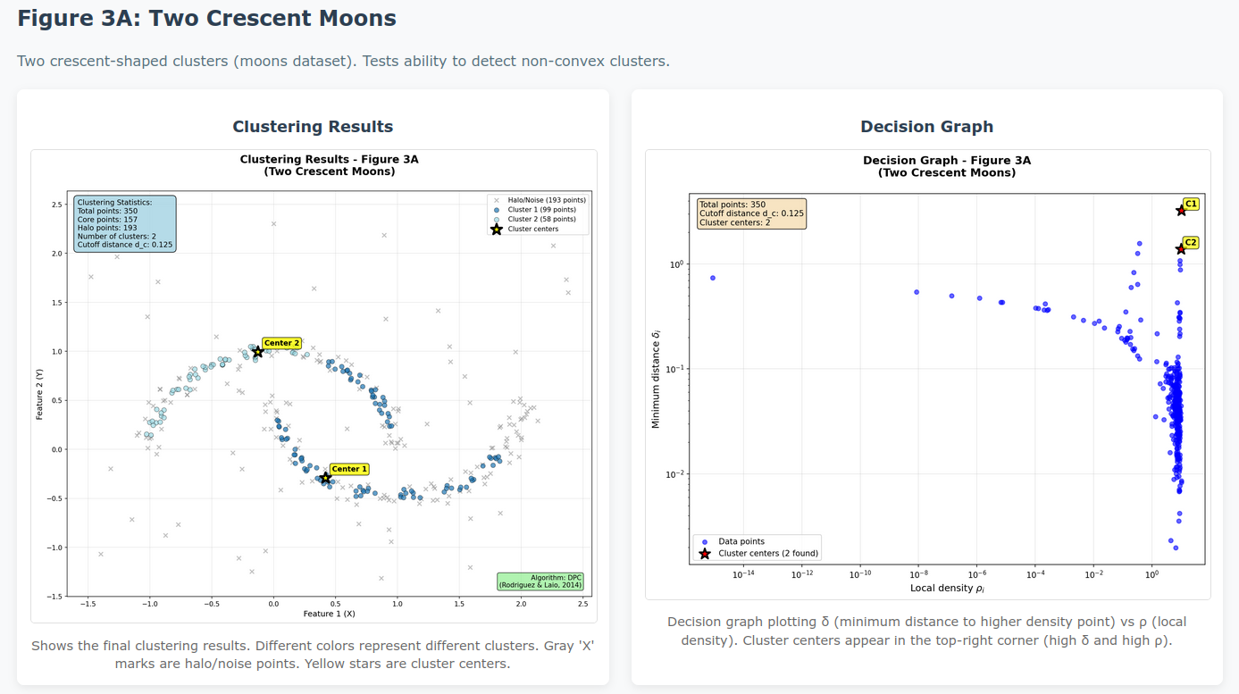

Slide 11
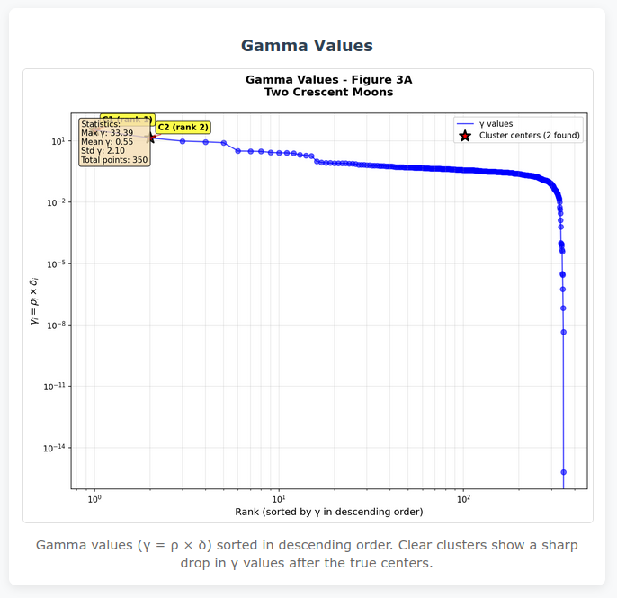

Slide 12
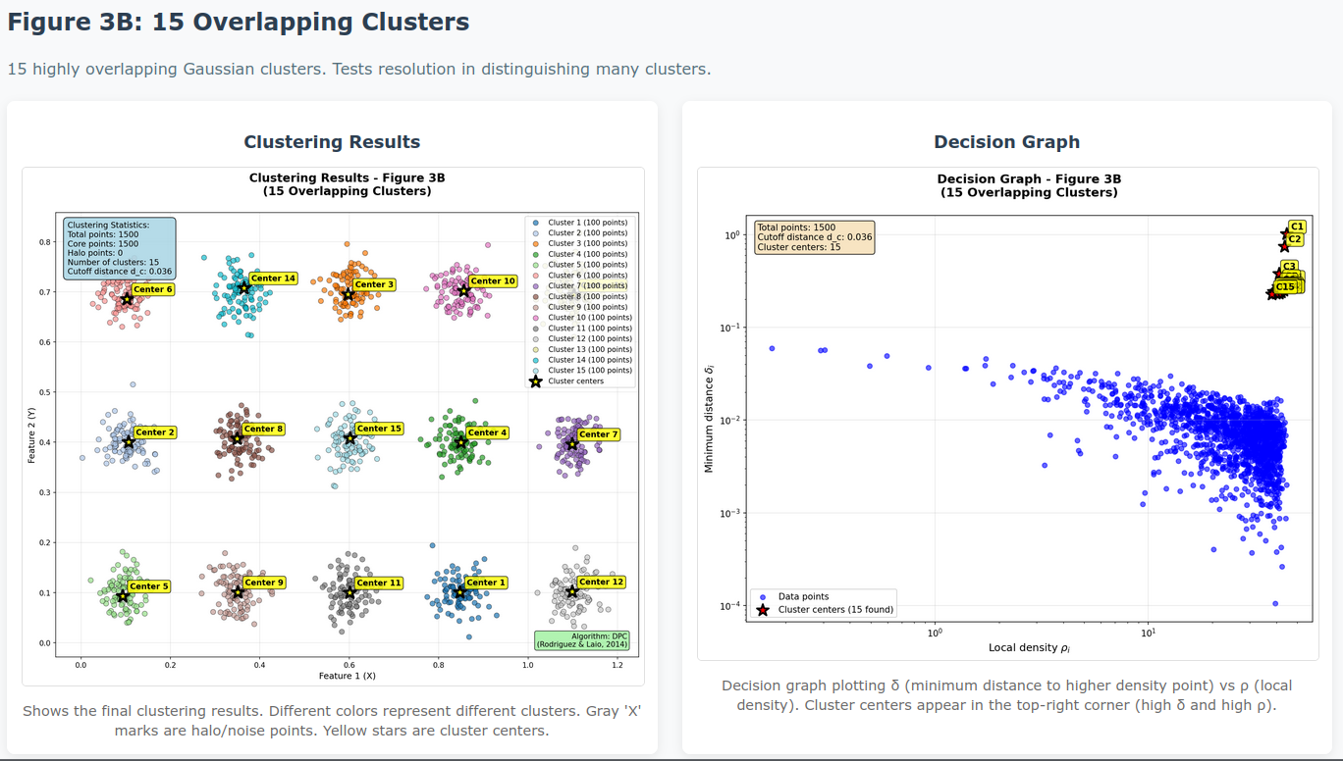

Slide 13
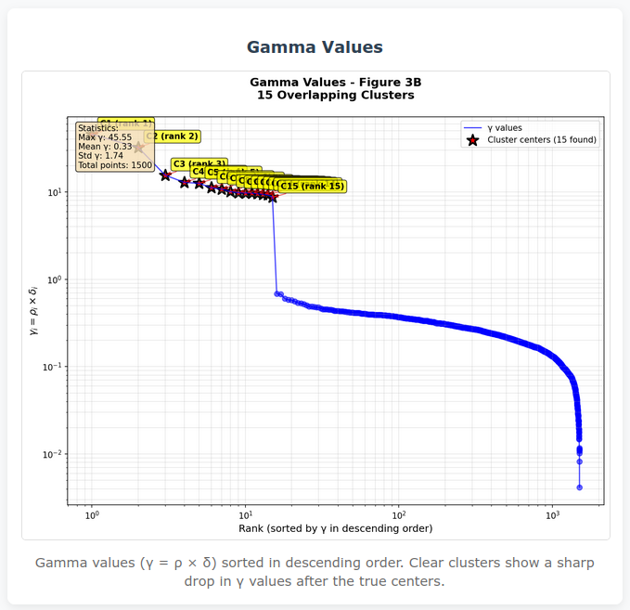

Slide 14
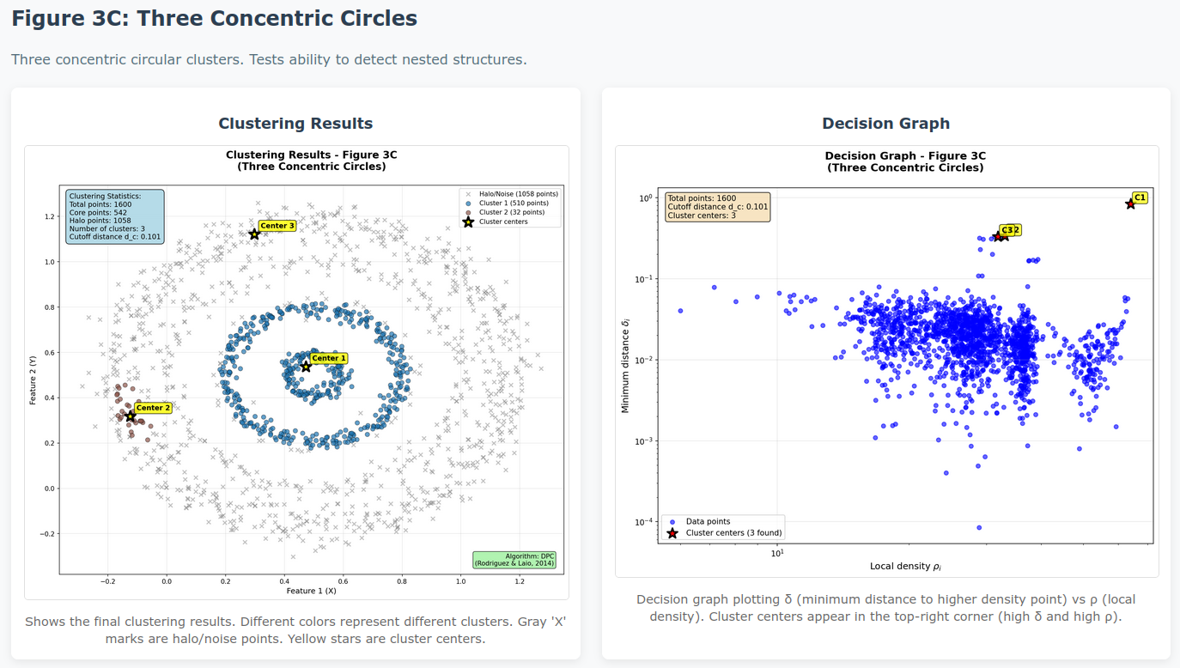

Slide 15
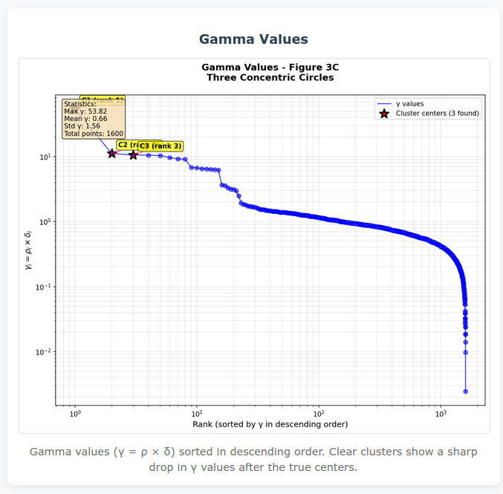

Slide 16
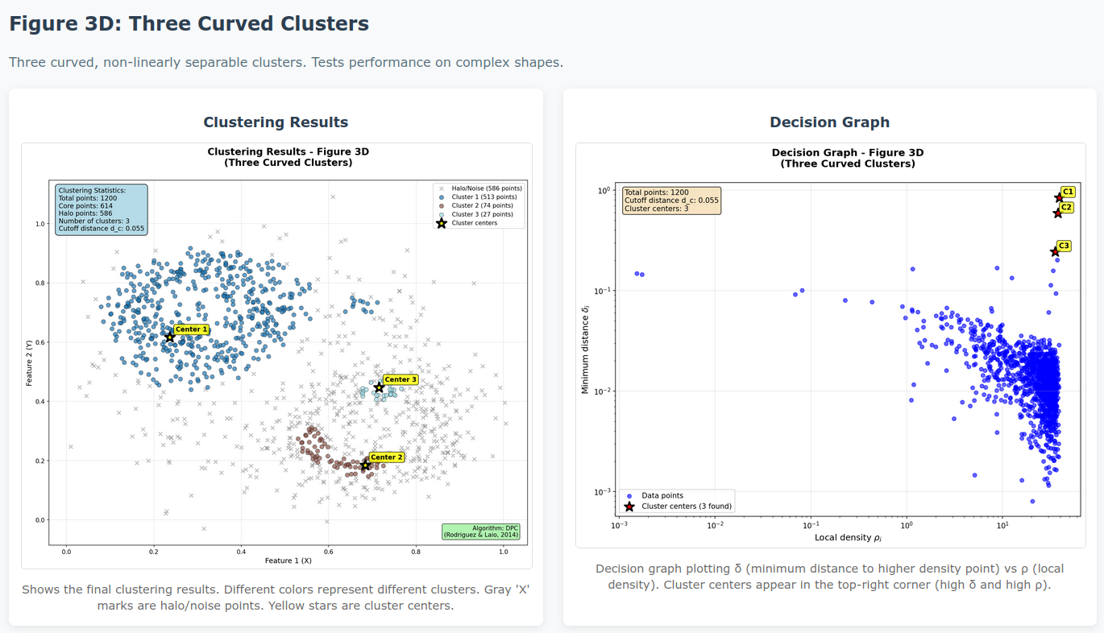

Slide 17
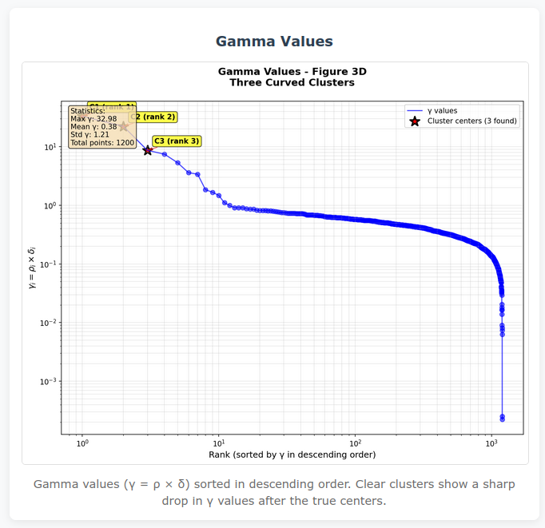

Slide 18
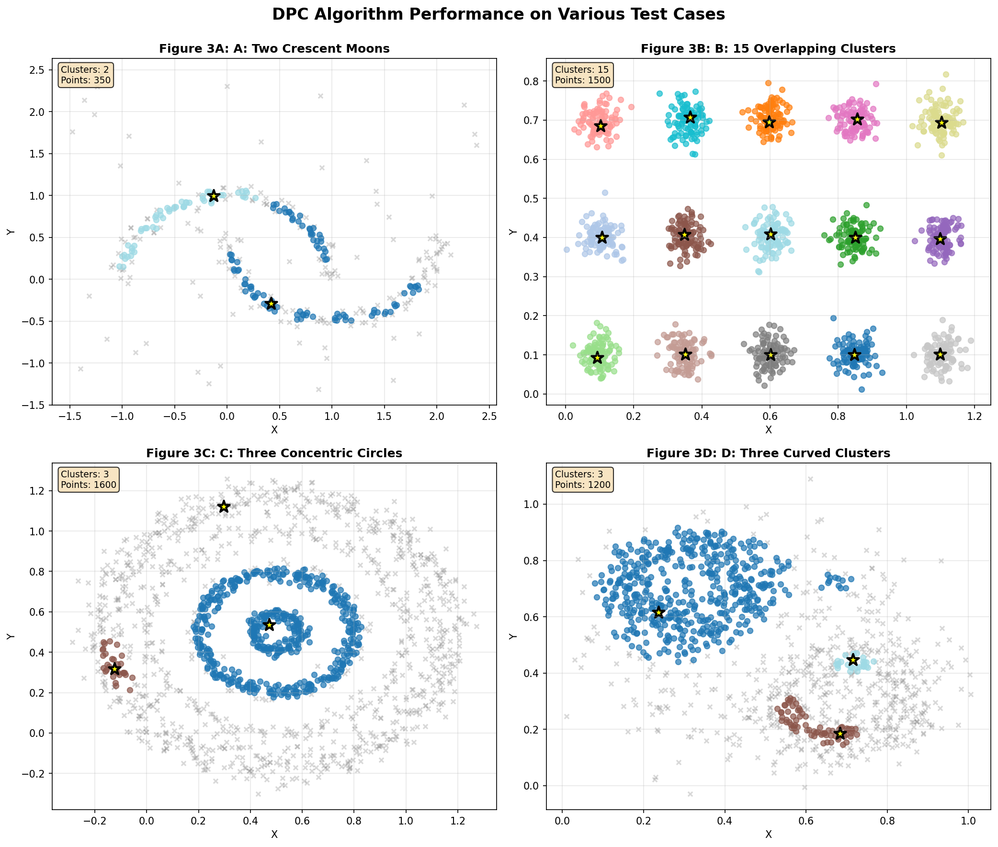

Slide 19
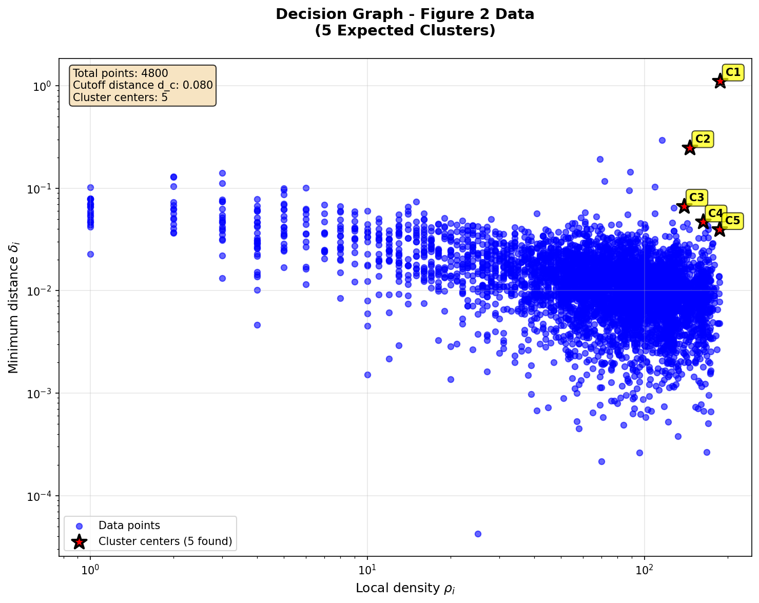
Understanding the Decision Graph
What is a Decision Graph?
A scatter plot of δ (vertical axis) vs ρ (horizontal axis) where:
X-axis (ρ): Local density (log scale)
Y-axis (δ): Distance to nearest higher density point (log scale)
How to Interpret:
Cluster Centers: Points in top-right corner (high ρ AND high δ)
Regular Points: Bottom region (low δ, variable ρ)
Outliers/Halo: Top-left corner (high δ but low ρ)
Border Points: Points with density below cluster border density
Critical Insight from Experiment:
The original paper's key contribution is visual: cluster centers are visually identifiable in the decision graph as isolated points in the top-right region, not just points with high γ = ρ × δ.

Slide 20
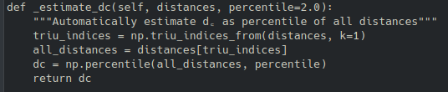
Impact of Cutoff Distance d꜀
Experimental Investigation: Tested d꜀ values: [0.05, 0.06, 0.07, 0.08, 0.09, 0.10, 0.12, 0.15]
Findings:
Too small (d꜀ = 0.05): Density estimates too sparse, centers unclear
Optimal (d꜀ = 0.08): Clear separation in decision graph, ARI = 1.000
Too large (d꜀ = 0.15): Density estimates too coarse, clusters merge
Rule of Thumb Confirmed: Choose d꜀ so average number of neighbors is 1-2% of total points.
Practical Implementation:

Slide 21
DPC vs Other Clustering Algorithms
K-means Comparison:
DPC Advantage: No need to specify K, finds non-spherical clusters
Evidence: K-means fails on crescent moons (Figure 3A)
Image: Reference from paper showing K-means failure
DBSCAN Comparison:
DPC Advantage: No global density threshold parameter
Evidence: DPC automatically separates halo from core points
Implementation: Halo detection based on border density
Mean-shift Comparison:
DPC Advantage: More computationally efficient
Reason: No need to iteratively shift all points toward density maxima
Statistical Validation:
ARI Score: 1.0000 for Figure 2 (perfect)
Cluster Count: Matches expected values for all test cases
Visual Inspection: Clusters match human intuition

Slide 22
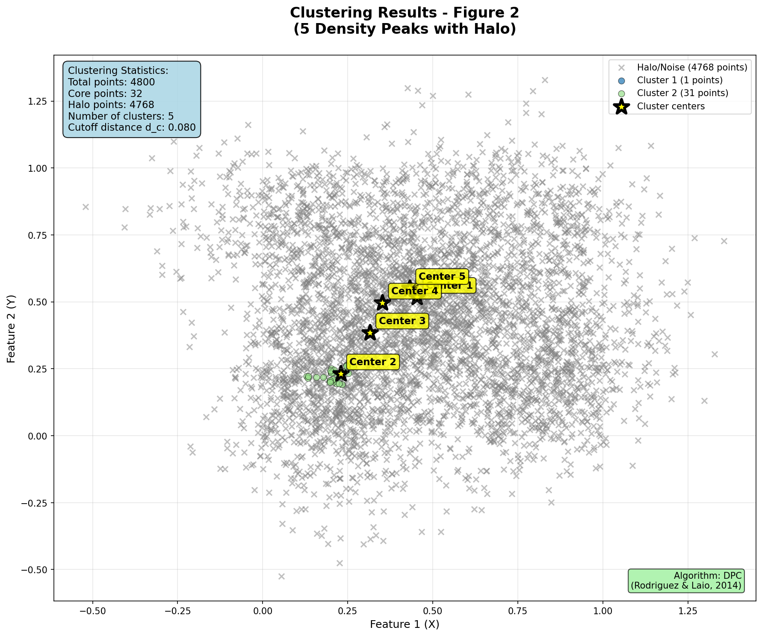
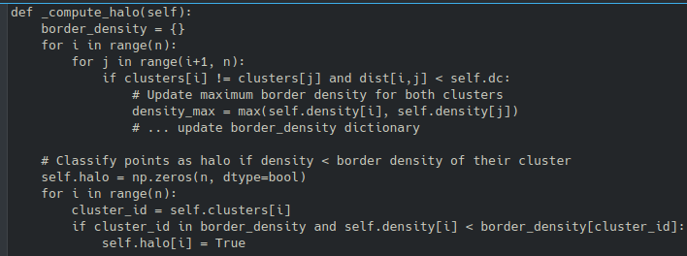
Automatic Noise/Outlier Identification
Algorithm for Halo Detection:
For each cluster, find its border region (points assigned to that cluster but within d꜀ of other clusters)
Find the point with highest density in the border region (ρ_b)
All points in the cluster with density < ρ_b are classified as halo (noise)
Implementation:
Gray 'x' markers show halo points automatically identified on cluster borders

Slide 23
Experimental Outcomes
Quantitative Results:
Qualitative Assessment:
Decision Graphs: Clearly show cluster centers as isolated points
Gamma Plots: Show sharp drops indicating natural cluster count
Visual Clustering: Matches human perception of clusters
Halo Separation: Effectively distinguishes core from noise
Test Case | Expected Clusters | Found Clusters | ARI Score
Figure 2 | 5 | 5 | 1.0000
Figure 3A | 2 | 2 | N/A
Figure 3B | 15 | 15 | N/A
Figure 3C | 3 | 3 | N/A
Figure 3D | 3 | 3 | N/A
Generated Outputs:
15 high-quality PNG plots matching paper figures
Interactive HTML report (experiment_report.html)
Complete code implementation
Detailed analysis documentation

Slide 24
Experimental Conclusions
Confirmed Paper Claims:
Cluster centers have both high density and large δ
Number of clusters emerges intuitively from decision graph
Algorithm works for arbitrary cluster shapes
Outliers automatically detected as halo points
Method is robust to choice of d꜀
Critical Implementation Insight:
The most important lesson was not in the mathematical formulation but in the visual interpretation of the decision graph. Successful center selection requires identifying points with BOTH high ρ AND high δ, not just high γ = ρ × δ.
Practical Recommendations:
Always visualize the decision graph before selecting centers
Use the γ plot as a secondary validation tool
Experiment with different d꜀ values (1-2% neighbor rule)
Consider Gaussian kernel for small datasets

Slide 25

Sources and Resources
Primary Reference:
Rodriguez, A., & Laio, A. (2014). Clustering by fast search and find of density peaks. Science, 344(6191), 1492-1496.
Code Dependencies:
NumPy, SciPy: Numerical computations
Matplotlib: Visualization
scikit-learn: Comparison algorithms and metrics
tqdm: Progress bars
Experimental Validation:
Adjusted Rand Index (ARI) for quantitative assessment
Visual inspection against paper figures
Parameter sensitivity analysis
Project on GitHub

